Slide 1
When Privacy is Compromised: The Ethical Fallout of Government Backdoors
By: Jack Peduzzi & Grace Fratz

Slide 2
Introduction
Cryptography has been used in computing since the 1970's
Extremely important for securing information
Will be undermined if a deliberate backdoor is implemented
Allowing this will cause the loss of public trust due to the fear of surveillance
Lack of security for data
Unenforceable across foreign borders

Slide 3
Literature Review
Cryptographic algorithms facilitate the safe transfer of data, passwords, and more
One of the first major implementations was heralded by Horst-Feistel
Known as Data Encryption Standard (DES) - Now obsolete
Diffie-Hellman key exchange – birth of asymmetric encryption
Asymmetric Encryption: “an encryption method that uses two different keys, a public key and a private key-to encrypt and decrypt data."[3]
Uses Public Key Infrastructure
Public Key - Public keys are used for encrypting data and verifying digital signatures [7]
Private Key - Private keys are keys that are meant to stay secure and are used to decrypt and digitally sign data.[8]
Symmetric Encryption: “a type of encryption key management solution where only one key (a secret key) is used to both encrypt and decrypt electronic data.” [10]

Slide 4
Methodology
Reputable organizations such as NIST and The Department of Defense provide guidelines for cybersecurity practices.
A current guideline heralded by NIST is the Cryptographic Module Validation Program (CMVP). [12] NIST defines the goal of the CMVP to , “... promote the use of validated cryptographic modules and provide Federal agencies with a security metric to use in procuring equipment containing validated cryptographic modules”[13]
A backdoor defined by NIST is, "an undocumented way of gaining access to a computer system. A backdoor is a potential security risk [16].
The implementation of a deliberate backdoor would by definition, make every cryptography algorithm insecure

Slide 5
Results & Analysis
Granting law enforcement and government officials backdoor access to encrypted data is both dangerous and unethical
Allows attacks from
foreign adversaries
cyber criminals
Weakens the entire system as a whole

Slide 6
Foreign Advisories
Embedding a vulnerability within encryption systems
Compromises their integrity
Allows unauthorized individuals to exploit it
Countries like China, Russia, and Iran have successfully conducted cyberattacks against U.S. systems in the past
Adversaries are adopting cutting-edge tools such as
Artificial intelligence
Cyber weapons
Advanced surveillance technology
Technology has become too advanced and too accessible for the United Sates to risk putting in a backdoor.
2020 SolarWinds attack
Attack from Russian Intelligence
Compromised multiple federal agencies and private sector organizations
Russian attackers infiltrated SolarWinds’ Orion platform by inserting a backdoor into a software update and used a supply chain attack
This malware remained dormant for around 2 weeks before establishing communication with command-and-control servers
Allowed attackers to extract sensitive data without immediate detection and remain inside systems for nine months on thousands of networks

Slide 7
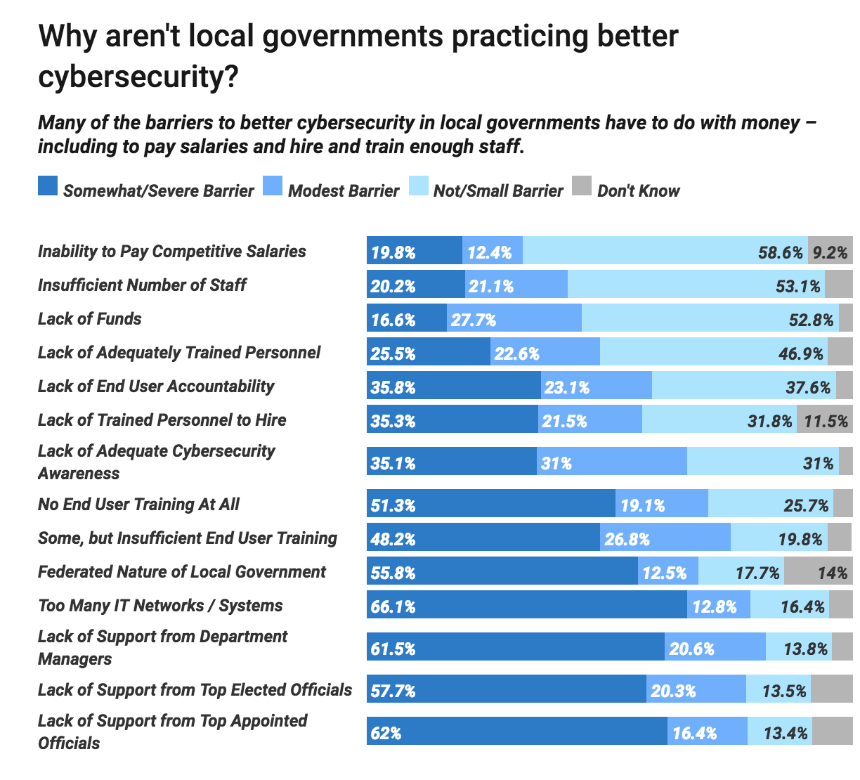
Cyber Criminals
Law enforcement is overwhelmed, overworked, understaffed, and underpaid.
They do not have the proper resources needed to protect the community and private data
“... law enforcement cannot prevent foreign actors from exploiting the same backdoor—now a vulnerability—to steal information.” [19]
Malicious actors and cyber criminals' prey on unsecure and secure data so it is crucial that guidelines written by organizations are followed.
If there are not enough resources going into law enforcement to protect our data, then they should not have easy access to it.

Slide 8
Weakened System
“...advocates of built-in backdoors either ignore or dismiss the fact that weakened encryption, at best, jeopardizes Americans’ privacy and, at worst, imperils national security. [19]
No feasible way for cybersecurity professionals, federal employees, or law enforcement officers to properly monitor the backdoor to ensure it is safe against hackers.
Once a backdoor is created, it becomes a matter of time for nefarious actors to discover and exploit it
Creating a backdoor
undermines the purpose of encryption
Opens the flood gates to exploitation which would put both individual privacy and national security at unprecedented risk.

Slide 9
Discussion & Implications
Government-imposed vulnerabilities in encryption systems risk
Loss of trust from public
Enables unchecked surveillance
Unenforceable across boarders
A sound national cryptography policy must balance the competing demands of public safety, privacy, and global security leadership
Supporting the broad, secure use of encryption to defend against both domestic and foreign threats.

Slide 10
Untrusting Public
“The rise of digital authoritarianism and the increasing sophistication of surveillance technologies pose substantial threats to democratic values and individual privacy.” [18]
fundamental right to privacy as well as a constitutional right to freedom of speech
Backdoor risks
Violation of their privacy
Fourth amendment right
NSA Warrantless Search Program
Following 9/11, U.S. government launched the Terrorist Surveillance Program
Authorized the NSA to monitor communications involving individuals located outside the United States without obtaining a warrant
This program collected metadata from all forms of communications
Even when individuals had NO ties to terrorism
This was a massive issue because it
Violation of the 4th amendment
Lack of transparency and oversight
Overreach and mass data collection
Legal and ethical backlash
Massive impact on public trust

Slide 11
Unchecked Surveillance
2013 NSA Information Leak
NSA was collecting millions of records from Americans
Gained direct access to serves of nine major internet companies including
Facebook, google, Microsoft
Conducted 61,000 hacking operations globally
Edward Snowden leaked this information
Currently resides in Russia where he is granted asylum
Illustrates that even without a legally mandated backdoor, the government has engaged in widespread surveillance practices, raising serious concerns about its ability to safeguard personal data.

Slide 12
Unenforceability Across Boarders
Cyber criminals and malicious actors can use foreign software and apps that do not comply with a country's backdoor law
Any laws mandating the inclusion of backdoors would not apply to encryption tools that are open-source or developed outside national jurisdictions.
“Yes, it will catch criminals who are too stupid to realize that their security products have been backdoored or too lazy to switch to an alternative, but those criminals are likely to make all sorts of other mistakes in their security and be catchable anyway. The smart criminals that any mandatory backdoors are supposed to catch—terrorists, organized crime, and so on—will easily be able to evade those backdoors. Even if a criminal has to use, for example, a US encryption product for communicating with the world at large, it is easy for him to also use a non-US non-backdoored encryption product for communicating with his compatriots.” [23]

Slide 13
Future Research
Further empirical research must be conducted to evaluate the true impact of backdoor access on crime prevention and prosecution
Insufficient evidence to determine whether the absence of such access significantly affects law enforcement's ability to investigate and prosecute serious criminal activity
Examining case studies, statistical data, and interviews with investigators to assess how often encryption directly impedes justice
Without solid evidence, policy decisions around encryption backdoors risk being driven more by fear and assumption than by facts and effectiveness

Slide 14
Conclusion
Cryptography is a foundational pillar of digital security in both personal and national contexts
Mandating backdoors in encryption software, no matter how well-intentioned, introduces fatal flaws that compromise these protections
The argument that backdoors could help law enforcement must be balanced against the overwhelming risks:
weakening national security
violating civil liberties
eroding public trust
enabling foreign cyberattacks.
A backdoor cannot be securely implemented or effectively limited to its intended use

Slide 15
Works Cited
[3], [7], [8], [10] A. Badman and M. Kosinski, “What is Asymmetric Encryption? | IBM,” Ibm.com, Aug. 08, 2024.
[12], [13] Computer Security Division, Information Technology Laboratory, National Institute of Standards and Technology, U.S. Department of Commerce, “Cryptographic Module Validation Program | CSRC,” Nist.gov, 2016. https://csrc.nist.gov/projects/cryptographic-module-validation-program
[18]A. Sahai, “What is Supply Chain Attack in Cybersecurity? Its Types, Risks, and Common Sources,” Ampcus Cyber, Apr. 24, 2025. https://www.ampcuscyber.com/knowledge-hub/what-is-a-supply-chain-attack/
[19]K. Zetter, “DOJ Detected SolarWinds Breach Months Before Public Disclosure,” WIRED, Apr. 28, 2023. https://www.wired.com/story/solarwinds-hack-public-disclosure/?utm_source=chatgpt.com
[23], Third Way, “Weakened Encryption: The Threat to America’s National Security,” Thirdway.org, 2025. https://www.thirdway.org/report/weakened-encryption-the-threat-to-americas-national-security?utm_source=chatgpt.com

